Slide 1

EoTT Progress
& DTT Concept
Honda HALO
June, 2024

Slide 2
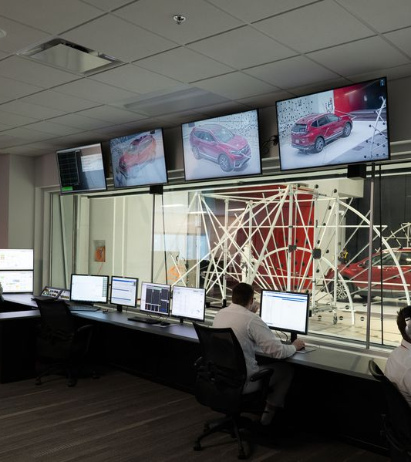
Agenda
EoTT Status
Prototype review for refresh on interface concept
Functional build at current state
DTT Findings & Recommendations
Definition findings
Solution concept prototype
Moving forward

Slide 3
End of Test Tool
Development Status
EoTT Figma prototype: Presented to review/refresh viewers of proposed solution
EoTT Development demo: Example of current status of the digital product solution
Next steps
Onsite on July 8th to test build with real test data
Launch product when Kaleb returns from paternity leave for GoKen weekend use

Slide 4
Downtime Tracker Tool
Findings & Recommendations
Definition findings: Share what we found in May engagement
DTT prototype: Recommendation for proposed solution
Next steps
Review phase one and two concepts
Discuss Cosworth needs (license and meetings)

Slide 5
Downtime Tracker Tool
Proposed Phases
Phase One: Build out the DTT as a digital manual entry solution.
Value: Improve reporting accuracy, reliability, convenience, and add standardized persistent data storage for reporting. Serve as a foundation for automation in Phase Two.
Phase Two: Integrate what we have learned about Cosworth data to be able to automate as much of the downtime tracking as possible.
Value: Adds automation to the tool to programmatically track data downtime data and reduces the load on Technicians so they don’t need to remember to add a log into a manual system.

Slide 6
Detailed DTT Phase One Benefits
Accurate Downtime Tracking
Add required fields to ensure all relevant data is captured
Constraints to ensure all data is within valid ranges
Remove transcription errors
Faster Automated Excel Reporting
Automatically export downtime data to Excel. This eliminates transcription time & errors.
Data is available immediately, rather than waiting for transcription to Excel
All data will also be stored in a database. This will help identify trends in facility downtime.
Multiple Data Views for a Variety of Data Consumers
GoKenClient View - Summary of up and down time without internal details
HALO Staff View - Detailed views for HALO technicians and management
Reporting Views - View reports in selected date ranges, sorting, and filtering. Easily integrate with power BI, visualization, and other software as needed.
Foundation for Automated Tracking via integration with Cosworth - research phase need due to long lead times (Cosworth engineer comms and facility time)

Slide 7
Thank You!
We look forward to working with you!

